Slide 1

Colgrow
Co L grow
NNECT.
EARN. .
BROUGHT TO YOU BY
PROTOTYPES

Slide 2

35-40% Shy People World-Wide

Slide 3


Slide 4

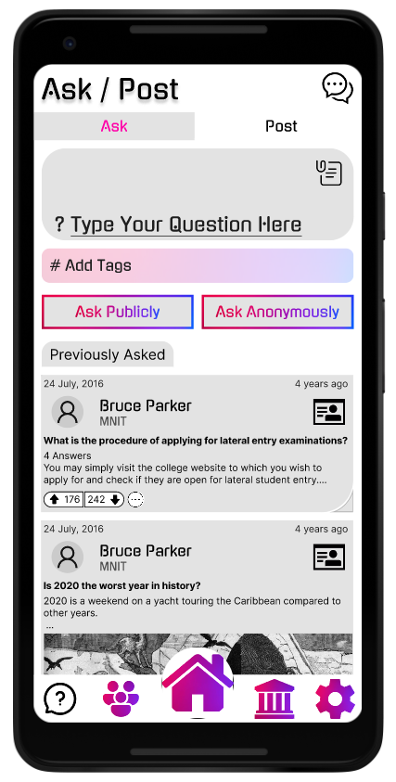
Ask/Post
Ask doubts
Post about what you are working on
Socialize

Slide 5

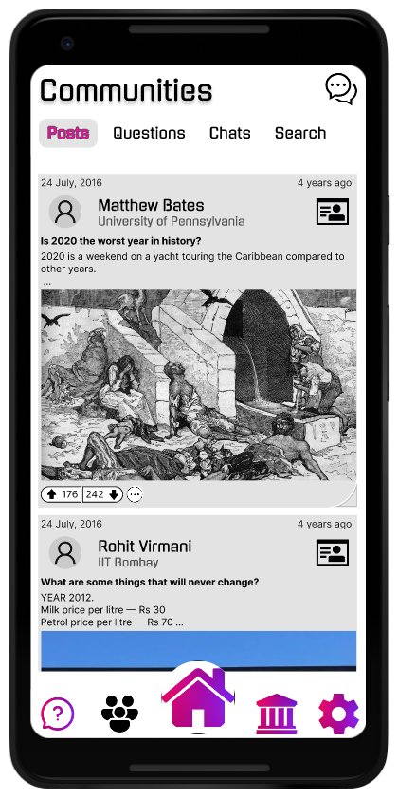
Communities
Connect with people of your interest
Learn and Collaborate
Grow stronger together

Slide 6
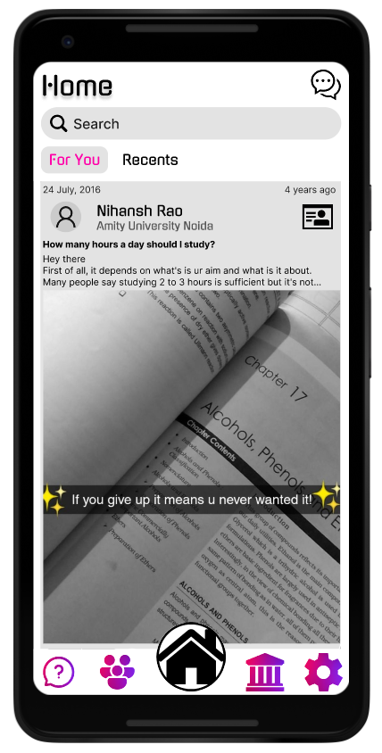
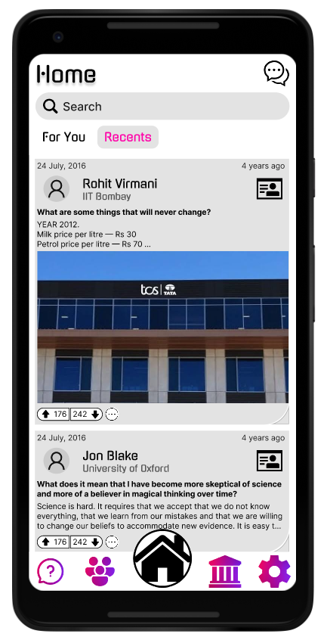
Feed
Browse content world-wide
Interact with posts that pique your interest
Answer questions

Slide 7
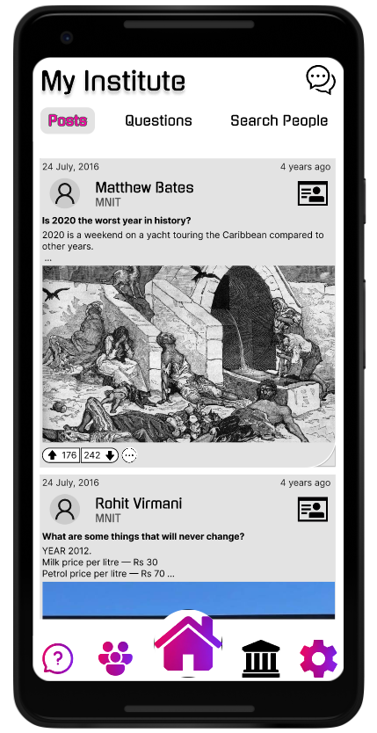
My Institute
Adapt to your institute’s environment
Mentor and get mentored
Develop better communion

Slide 8
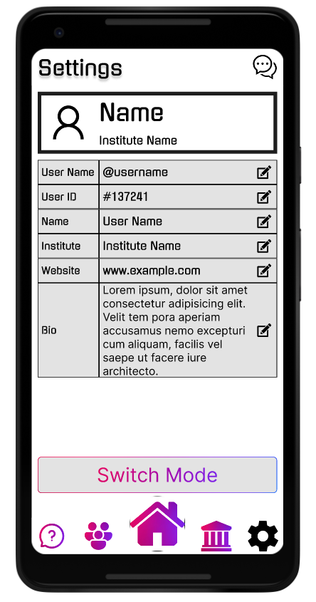

Settings
Info we need?
Student ID provided by your College
Enrollment Number
Phone Number for registration
Switch mode to
‘Go Anonymous’

Slide 9
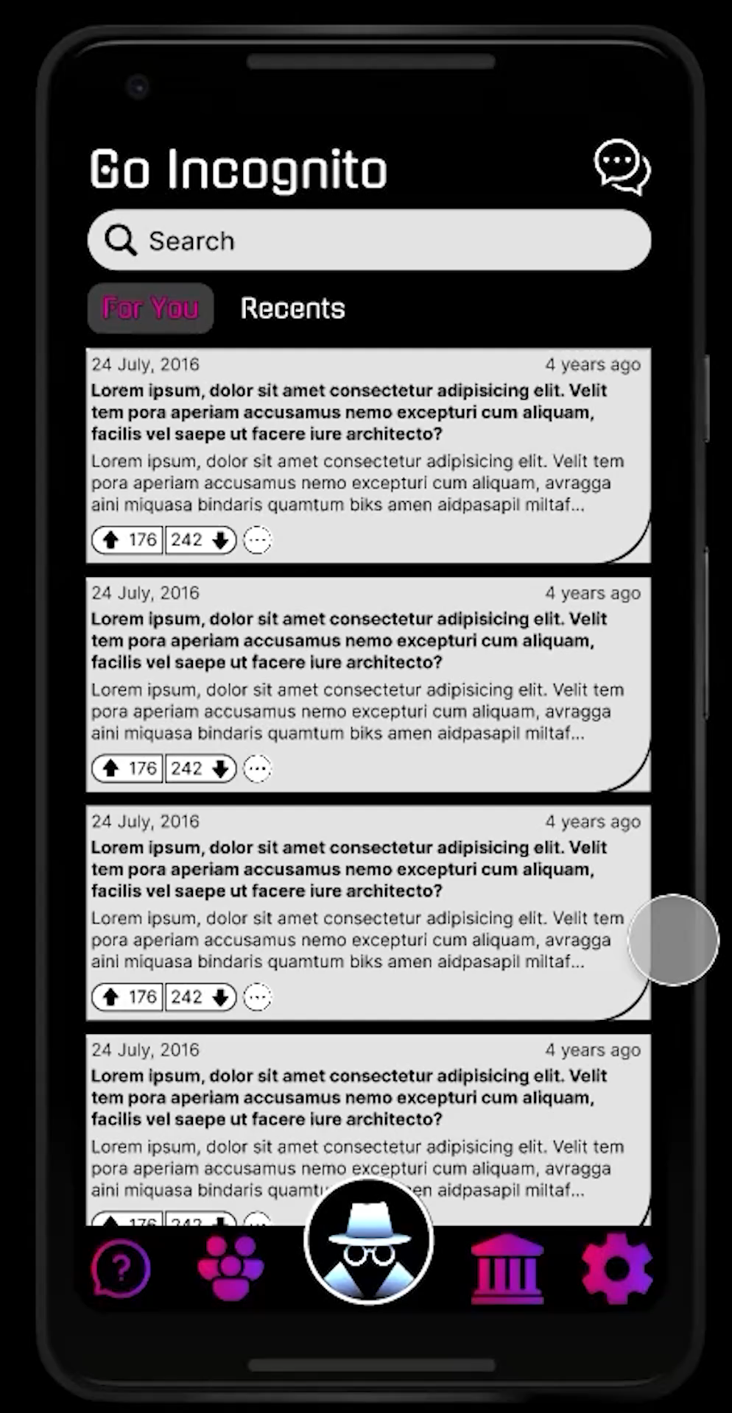
Communities (Anonymous)
My Institute (Anonymous)
Go Incognito Mode
Join public Communities Anonymously!
Don't hold back and ask away you queries anonymously in your institutes feed!
Anonymously browse through feed
Make anonymous connections
Bid farewell to your shyness

Slide 10

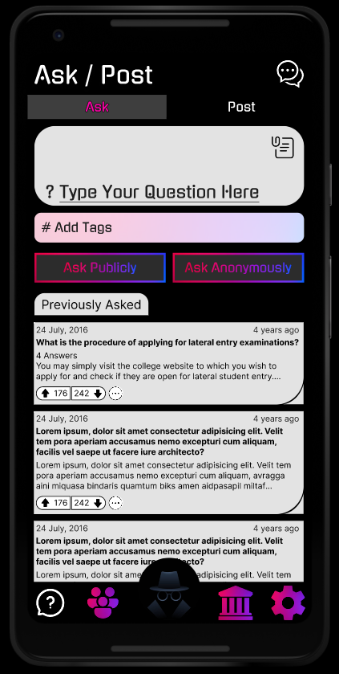
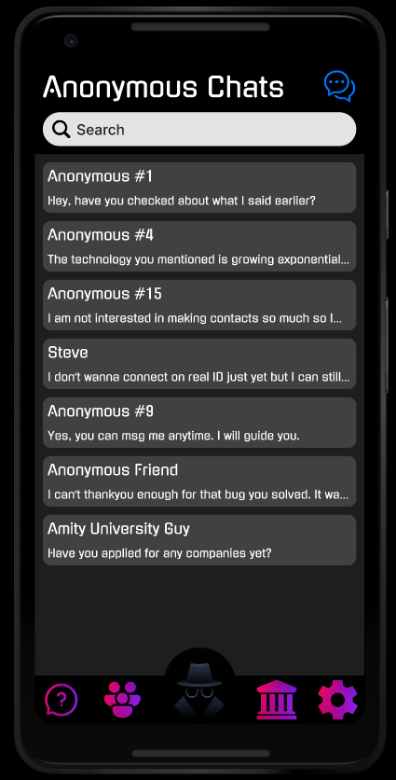
Ask / Post / Chat (Anonymously)
Ask questions without the fear of being judged
Chat anonymously for further doubt clarification

Slide 11

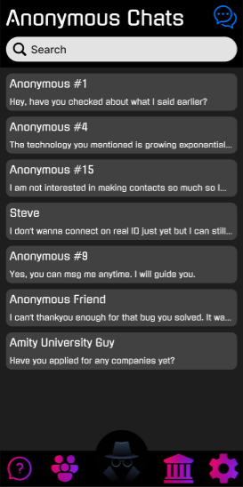
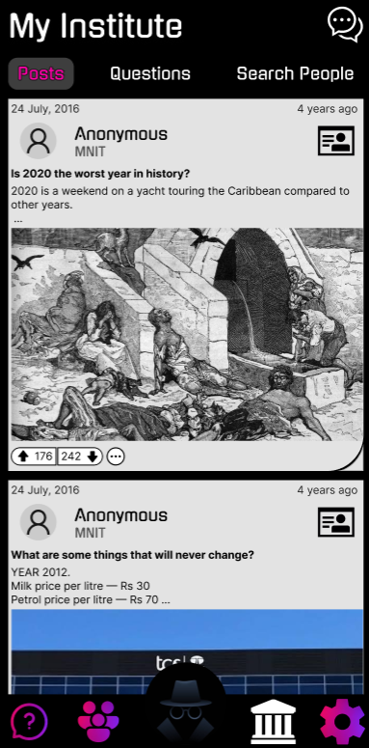
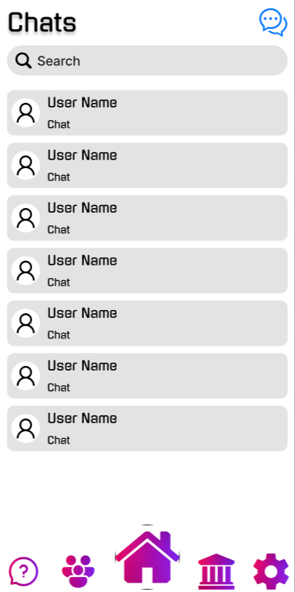
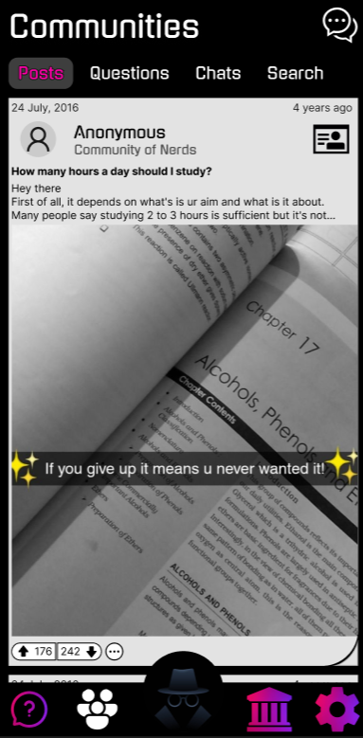
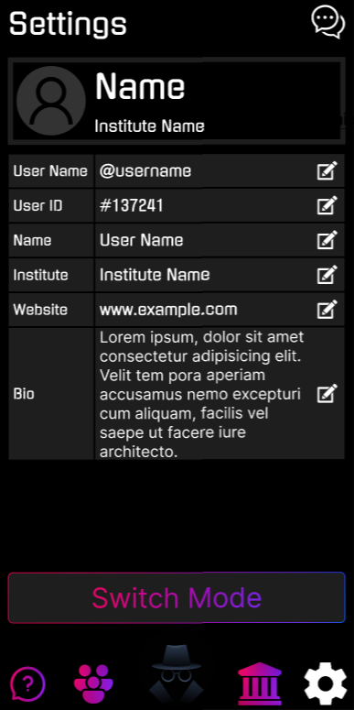
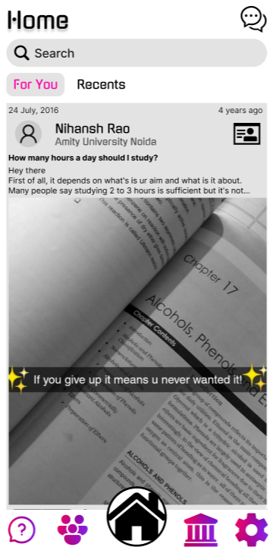
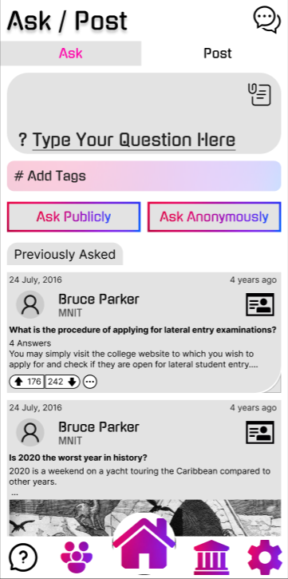
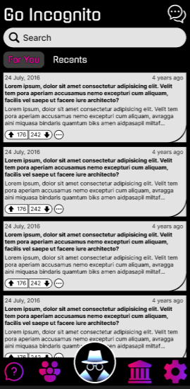
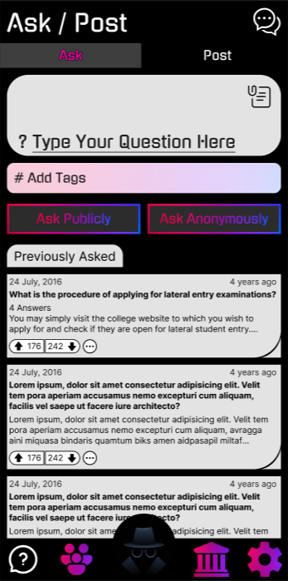
FEED
ASK/POST
COMMUNITIES
SETTINGS
MY INSTITUTE
CHATS

Slide 12

Colgrow
Co L grow
NNECT.
EARN. .
BROUGHT TO YOU BY
PROTOTYPES

